Slide 1
Reduced transmission when vaccinated
Parameter | Description
r_{x} | Rate of Vaccination in subpopulation x
β_{xy} | Per capita rate of transmission from infectious subpopulation y to susceptible subpopulation x
γ | Per capita rate of recovery
σ | Per capita rate of immunity loss (both vaccinated or naturally infected)
e_{ff1} | Vaccine Efficacy (preventing infection)
e_{ff2} | Vaccine Efficacy (preventing onwards infectiousness)
Probability of getting infected when vaccinated
Iv_{i}
(1-e_{ff2})(β_{ii} + …+ β_{xx})
(1-e_{ff1})(β_{ii} + …+ β_{xx})
γ
V_{i}
r_{i}
S_{i}
β_{ii}
I_{i}
γ
R_{i}
Population i
σ
σ
r_{i}
Compartment | Description (Proportion of population in…)
S_{x} | Susceptibles in subpopulation x
I_{x} | Infectious individuals in subpopulation x x
R_{x} | Recovered individuals in subpopulation x
V_{x} | Vaccinated individuals in subpopulation x
Iv_{x} | Vaccinated and infectious individuals in subpopulation x
r_{i}
Infecting Population I
(3 subpops i, j and k)
(β_{ii})(I_{i})(S_{i})
(β_{ij})(I_{j})(S_{i})
(β_{ik})(I_{k})(S_{i})
(1-e_{ff2})(β_{ii})(Vi_{i})(S_{i})
(1-e_{ff2})(β_{ij})(Vi_{j})(S_{i})
(1-e_{ff2})(β_{ik})(Vi_{k})(S_{i})
Subpopulation I infecting other subpopulations (3 subpops i, j and k)
(1-e_{ff1})(β_{ii})(I_{i})(S_{i})
(1-e_{ff1})(β_{ij})(I_{j})(S_{i})
(1-e_{ff1})(β_{ik})(I_{k})(S_{i})
(1-e_{ff1})(1-e_{ff2})(β_{ii})(Vi_{i})(S_{i})
(1-e_{ff1})(1-e_{ff2})(β_{ij})(Vi_{j})(S_{i})
(1-e_{ff1})(1-e_{ff2})(β_{ik})(Vi_{k})(S_{i})

Slide 2
$$\frac{dS_{i}}{dt}=σ{(V}_{i}+R_{i}){−β}_{ii}S_{i}I_{i}−β_{ij}S_{i}I_{j}−β_{ik}S_{i}I_{k}−{\left(1−e_{ff2}\right)β}_{ii}S_{i}{Vi}_{i}−(1−e_{ff2})β_{ij}S_{i}{Vi}_{j}−(1−e_{ff2})β_{ik}S_{i}{Vi}_{k}−r_{i}S_{i}$$
$$\frac{dI_{i}}{dt}=β_{ii}S_{i}I_{i}+β_{ij}S_{i}I_{j}+β_{ik}S_{i}I_{k}+{\left(1−e_{ff2}\right)β}_{ii}S_{i}{Vi}_{i}+\left(1−e_{ff2}\right)β_{ij}S_{i}{Vi}_{j}+\left(1−e_{ff2}\right)β_{ik}S_{i}{Vi}_{k}−γI_{i}−r_{i}I_{i}$$
$$\frac{dV_{i}}{dt}=r_{i}(S_{i}+I_{i}+R_{i})−{\left(1−e_{ff1}\right)β}_{ii}V_{i}I_{i}−{\left(1−e_{ff2}\right)β}_{ij}V_{i}I_{j}−{\left(1−e_{ff2}\right)β}_{ik}V_{i}I_{k}−$$
$$\left(1−e_{ff1}\right) {\left(1−e_{ff2}\right)β}_{ii}S_{i}{Vi}_{i}−\left(1−e_{ff1}\right)\left(1−e_{ff2}\right)β_{ij}V_{i}{Vi}_{j}−\left(1−e_{ff1}\right)\left(1−e_{ff2}\right)β_{ik}V_{i}{Vi}_{k}−σV_{i}$$
$$\frac{d{Vi}_{i}}{dt}={\left(1−e_{ff1}\right)β}_{ii}V_{i}I_{i}+{\left(1−e_{ff2}\right)β}_{ij}V_{i}I_{j}+{\left(1−e_{ff2}\right)β}_{ik}V_{i}I_{k}+$$
$$\left(1−e_{ff1}\right) {\left(1−e_{ff2}\right)β}_{ii}V_{i}{Vi}_{i}+\left(1−e_{ff1}\right)\left(1−e_{ff2}\right)β_{ij}V_{i}{Vi}_{j}+\left(1−e_{ff1}\right)\left(1−e_{ff2}\right)β_{ik}V_{i}{Vi}_{k}−γ{Vi}_{i}$$
$$\frac{dR_{i}}{dt}=γ\left(I_{i}+{Vi}_{i}\right)−r_{i}R_{i}−σR_{i}$$
Parameter | Description
r_{x} | Rate of Vaccination in subpopulation i
β_{xy} | Per capita rate of transmission from infectious subpopulation y to susceptible subpopulation x
γ | Per capita rate of recovery
σ | Per capita rate of immunity loss (both vaccinated or naturally infected)
e_{ff1} | Vaccine Efficacy (preventing infection)
e_{ff2} | Vaccine Efficacy (preventing onwards infectiousness)
Compartment | Description (Proportion of population in…)
S_{x} | Susceptibles in subpopulation x
I_{x} | Infectious individuals in subpopulation x x
R_{x} | Recovered individuals in subpopulation x
V_{x} | Vaccinated individuals in subpopulation x
Iv_{x} | Vaccinated and infectious individuals in subpopulation x

Slide 3
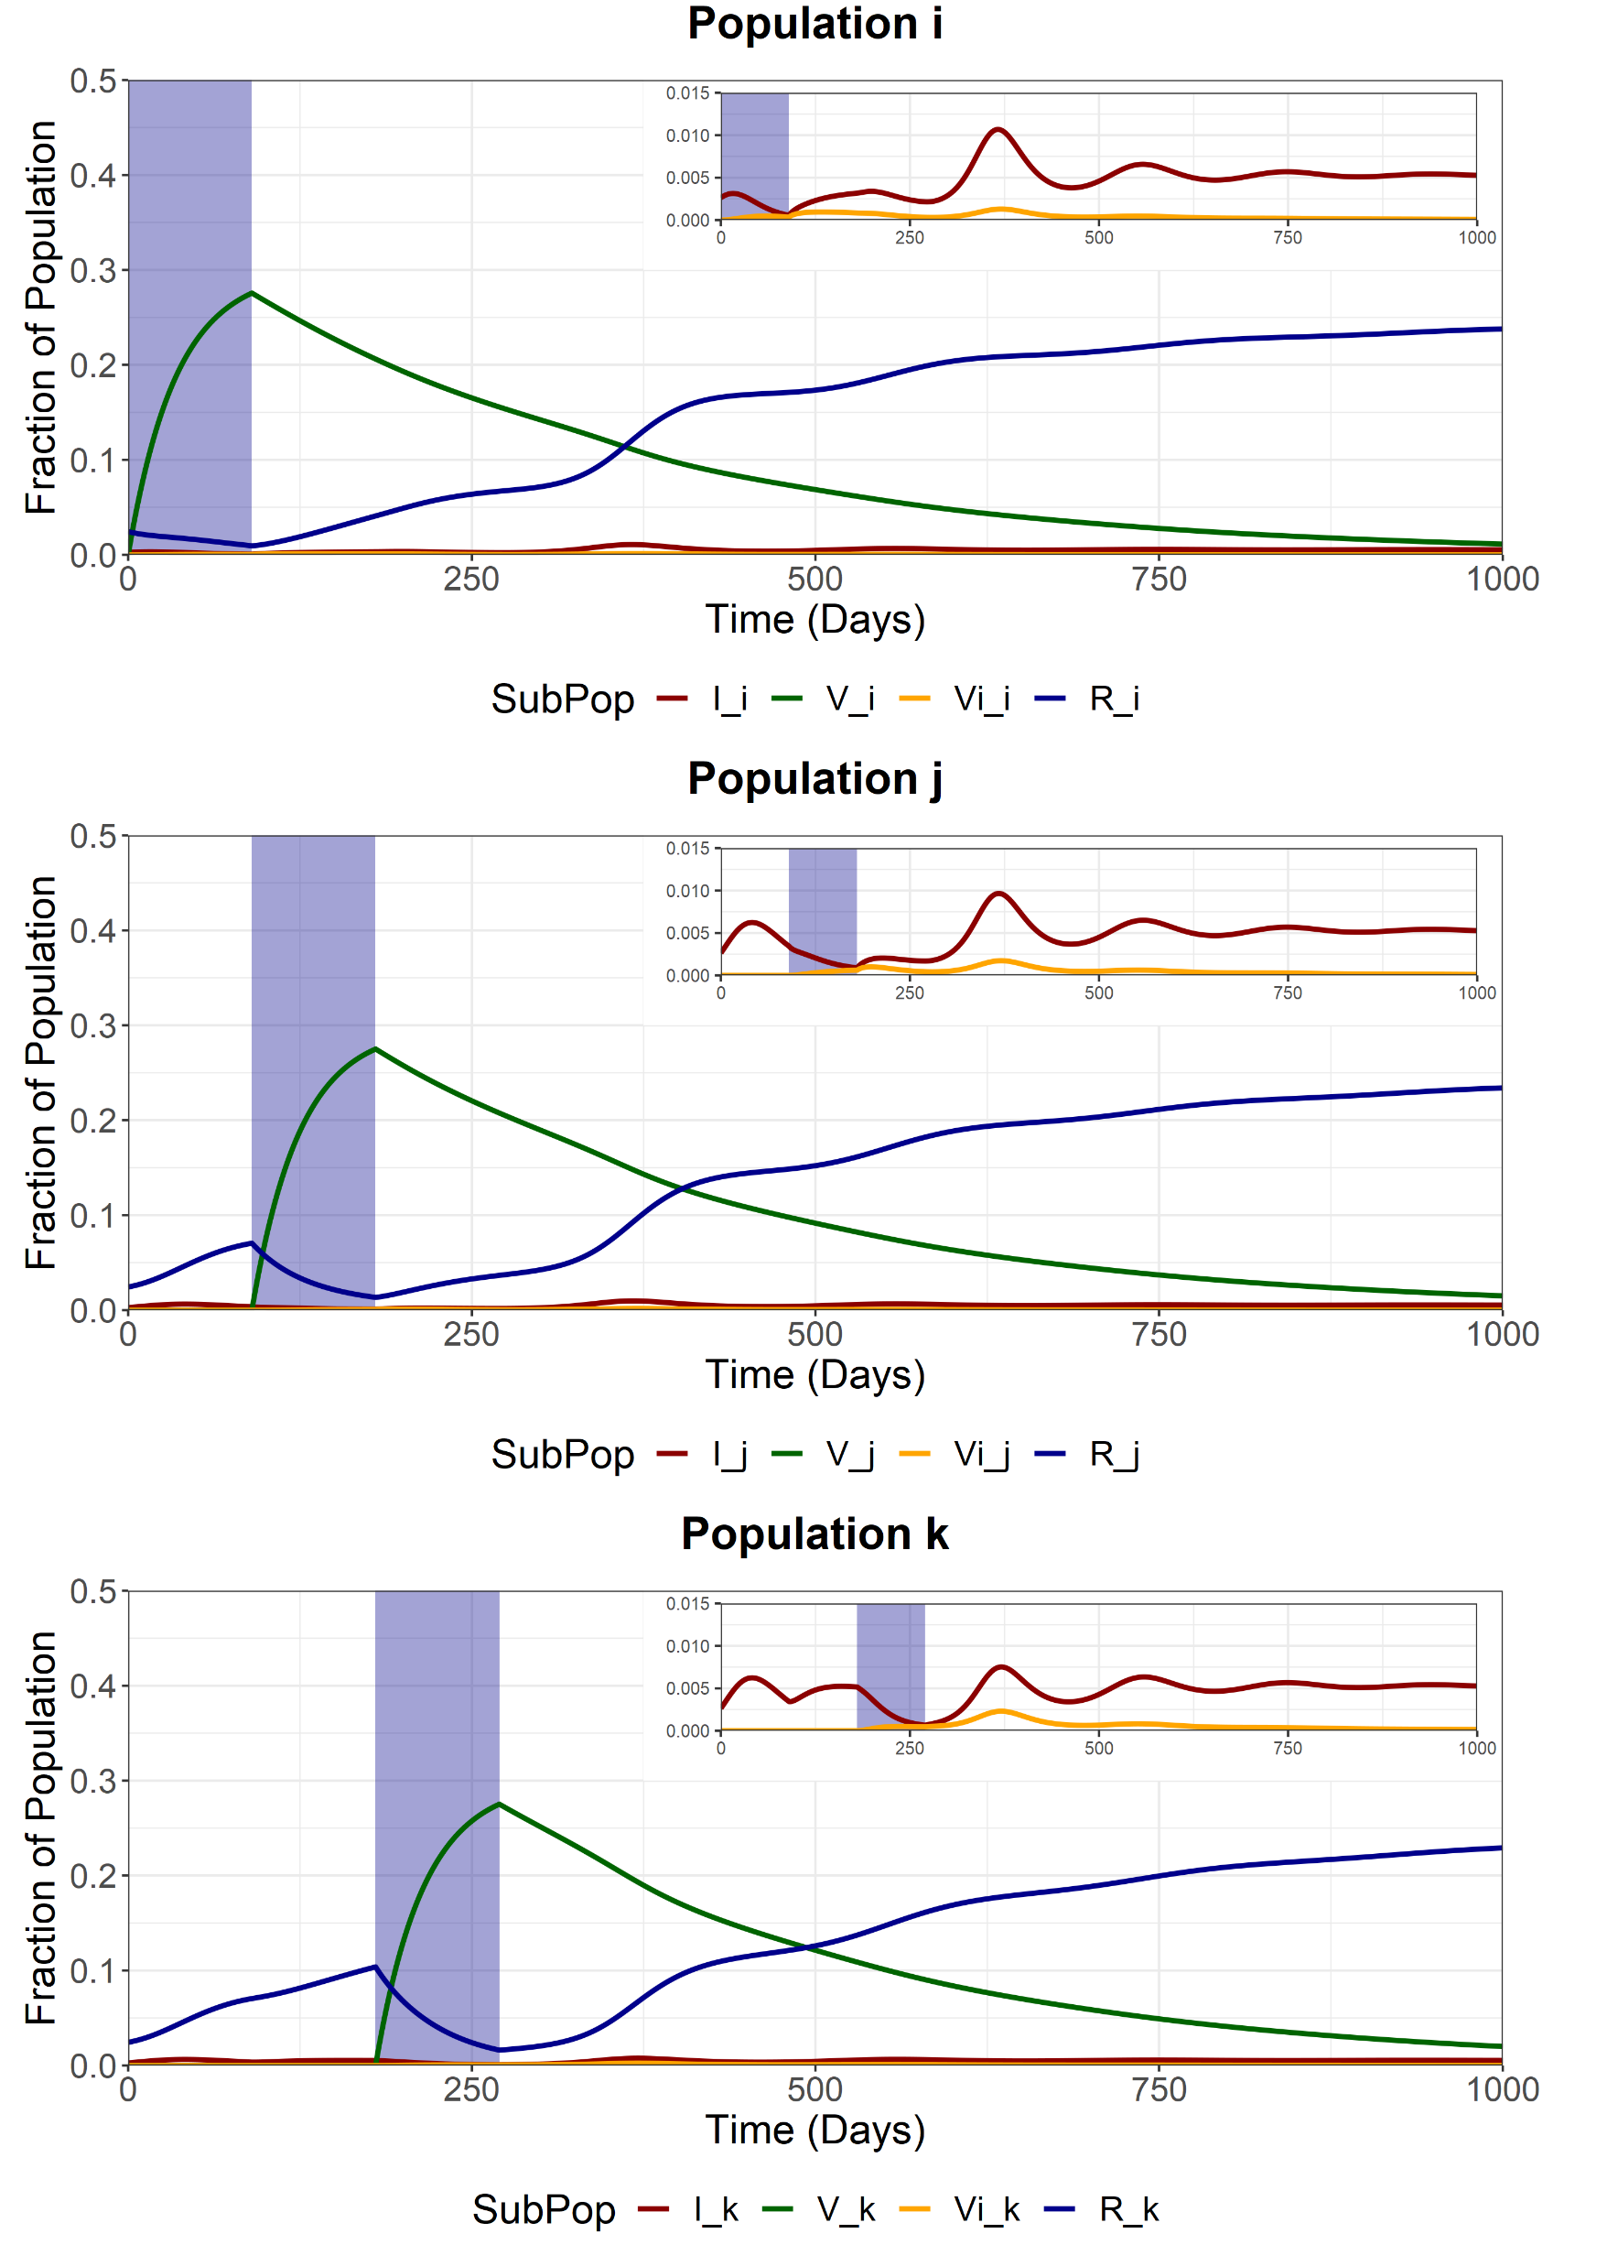
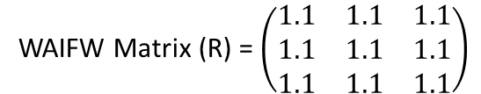
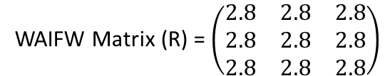
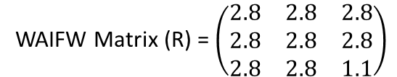
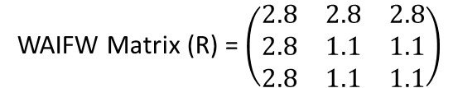
Scenario
We model sequential vaccination of 3 sub-populations. Each vaccination schedule lasts 90 days and aims for 90% coverage of the available susceptibles at the beginning of the simulation.
After vaccination of each subpopulation, the sub-population is released from NPIs, with the R increasing from 1.1 to 2.8.
We assume that 0.79% of the Scottish population is currently infected and 7.3% have already been infected and are now “Recovered”. Each subpopulation is proportionately the same size.
Vaccine efficacy is modelled at 90% (both eff1 and eff2) and coverage aims for 80% of the entire subpopulation
Subpopulation i
Target Coverage = 90%
Duration = 90 days
Trigger Date = day 0
Subpopulation j
Target Coverage = 90%
Duration = 90 days
Trigger Date = day 90
Subpopulation k
Target Coverage = 90%
Duration = 90 days
Trigger Date = day 180
Initial Conditions
S_{i} = 0.297633
S_{j} = 0.297633
S_{k} = 0.297633
I_{i} = 0.0071/3
I_{j} = 0.0071/3
I_{k} = 0.0071/3
V_{i} = 0
V_{j} = 0
V_{k} = 0
R_{i} = 0.1/3
R_{j} = 0.1/3
R_{k} = 0.1/3
WAIFW Matrix (R) = $\left(\begin{matrix}1.1 & 1.1 & 1.1 \\ 1.1 & 1.1 & 1.1 \\ 1.1 & 1.1 & 1.1\end{matrix}\right)$
During the pop i vaccination (t = 0-90)
WAIFW Matrix (R) = $\left(\begin{matrix}2.8 & 2.8 & 2.8 \\ 2.8 & 1.1 & 1.1 \\ 2.8 & 1.1 & 1.1\end{matrix}\right)$
During the pop j vaccination (t = 90-180)
WAIFW Matrix (R) = $\left(\begin{matrix}2.8 & 2.8 & 2.8 \\ 2.8 & 2.8 & 2.8 \\ 2.8 & 2.8 & 1.1\end{matrix}\right)$
During the pop k vaccination (t = 180-270)
WAIFW Matrix (R) = $\left(\begin{matrix}2.8 & 2.8 & 2.8 \\ 2.8 & 2.8 & 2.8 \\ 2.8 & 2.8 & 2.8\end{matrix}\right)$
After final vaccination schedule (t = 270-)

Slide 4
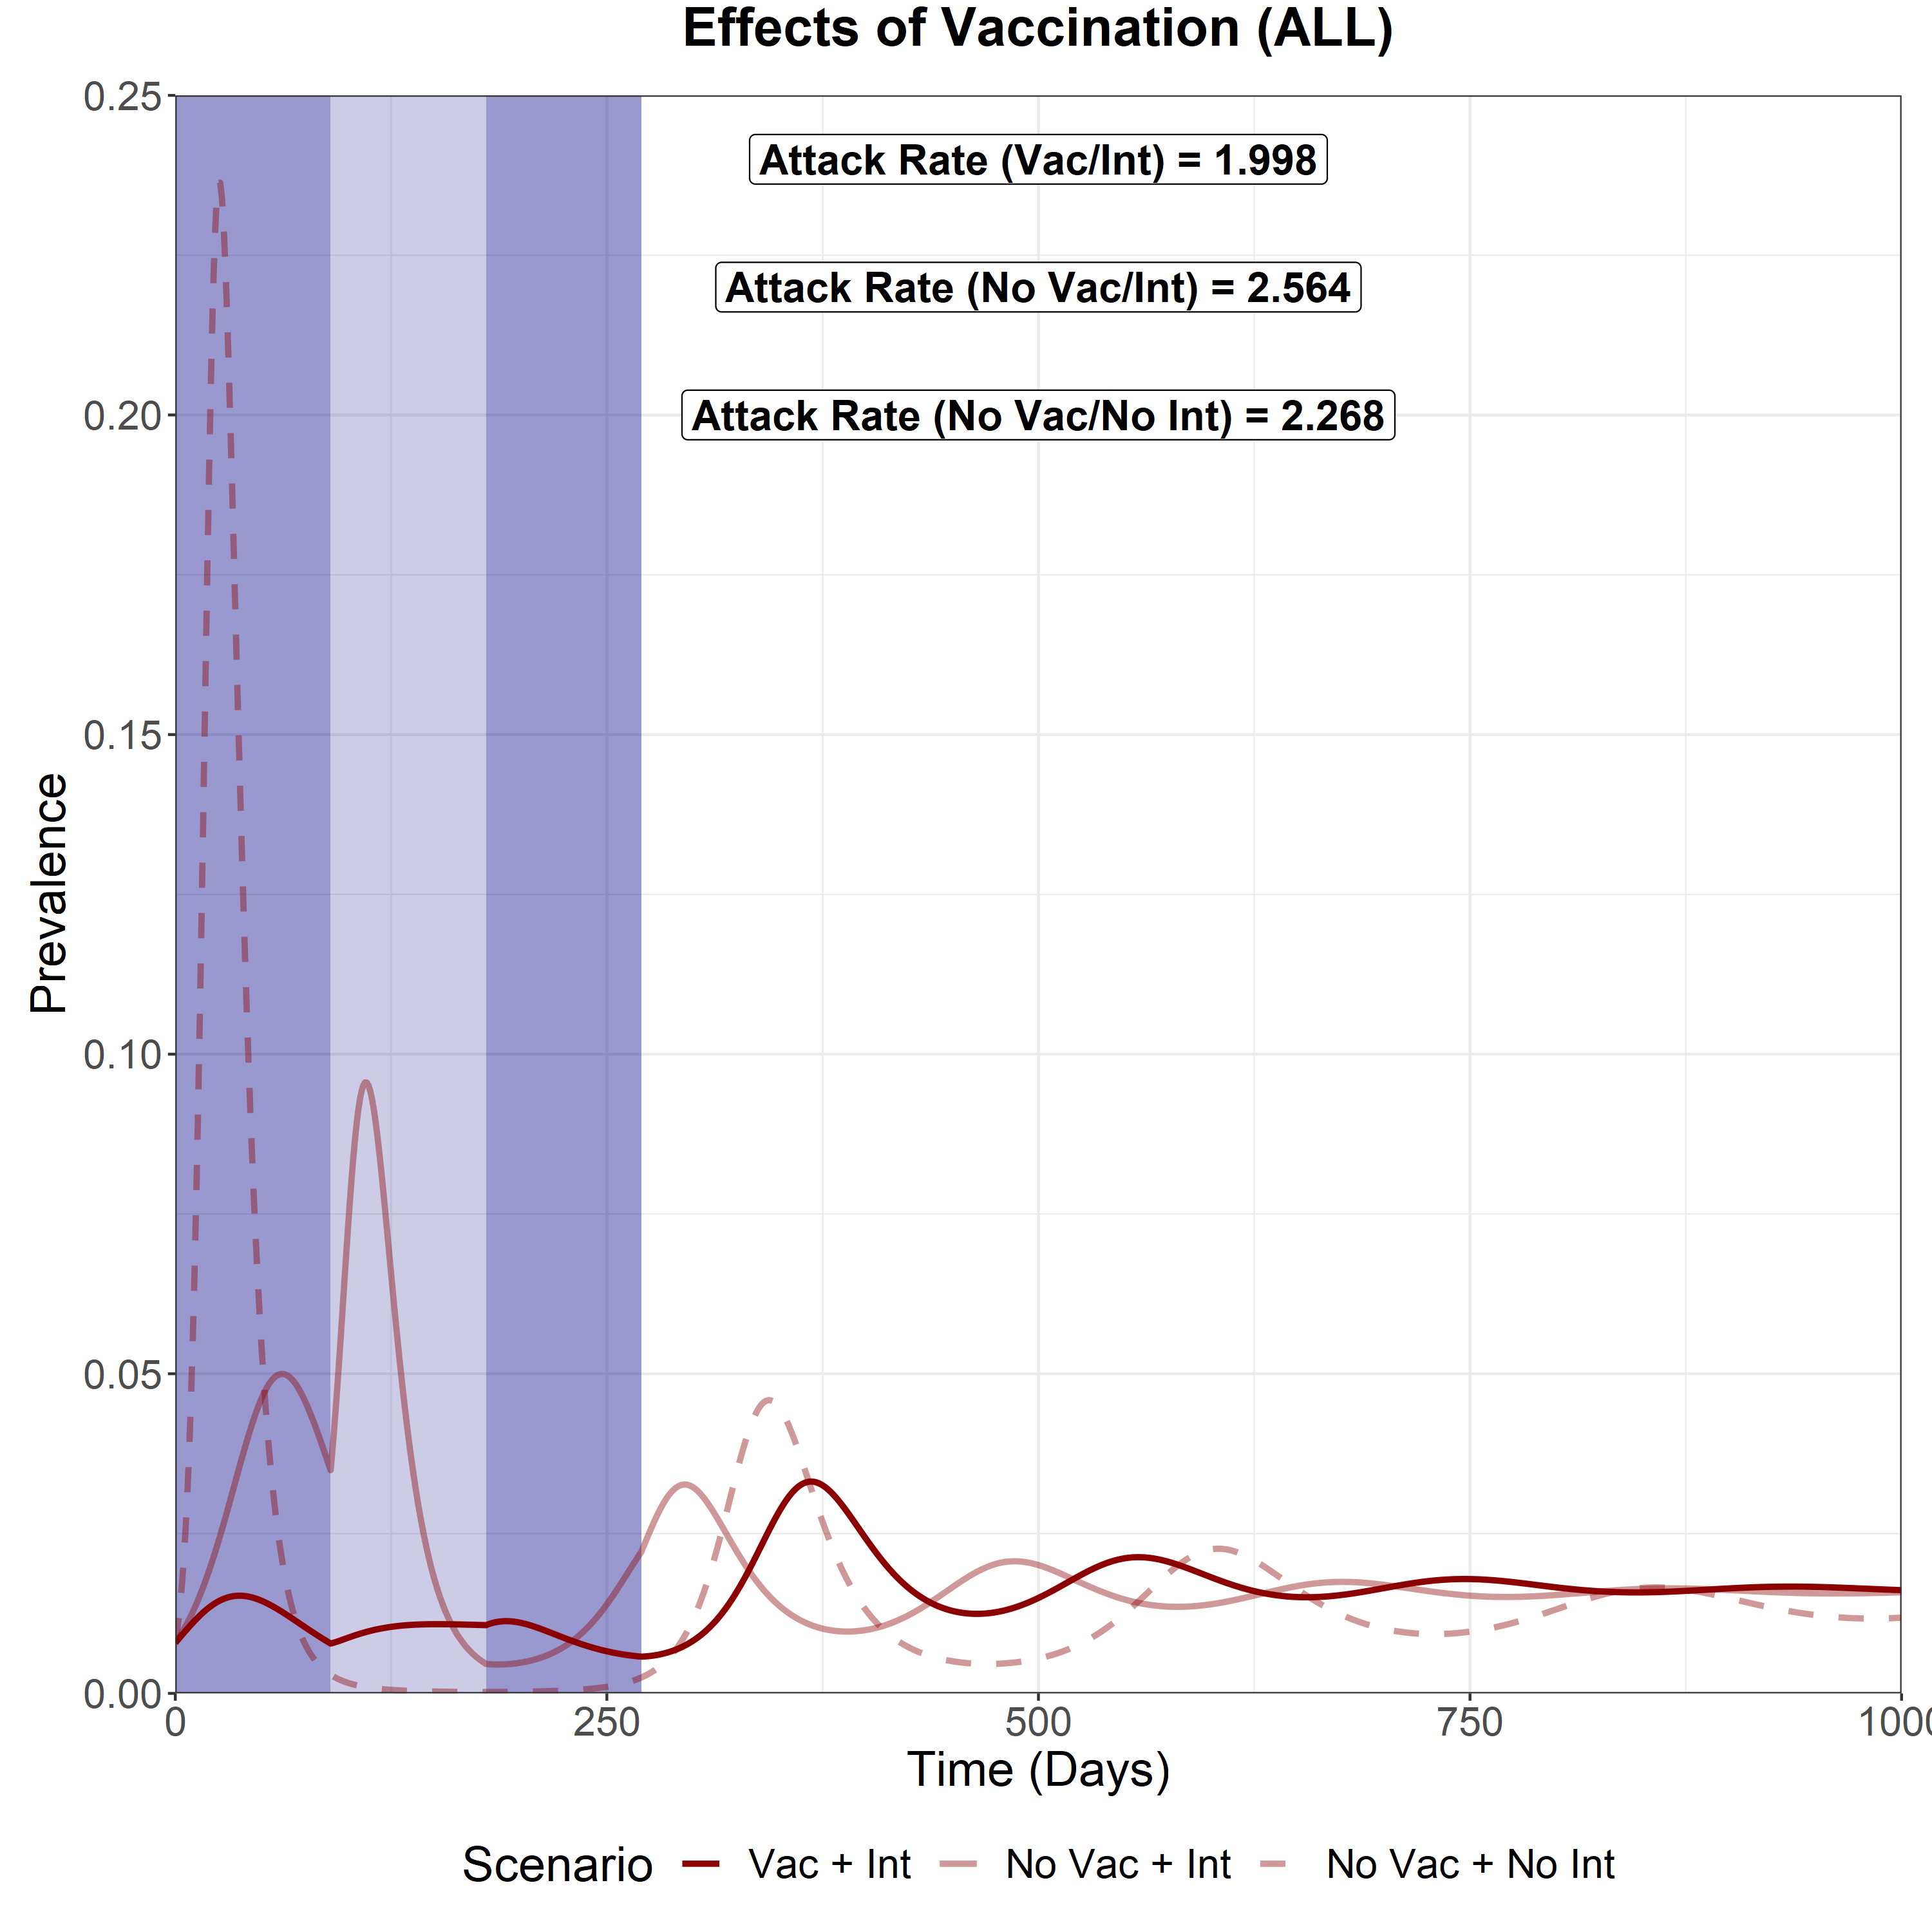
Scenario Analysis (Total)
We now compare the total epidemic curve (the sum of the infectious compartment in each subpopulation) for 3 different scenarios:
With vaccination and sequential intervention release
No vaccination but with sequential intervention release
No vaccination and no interventions
The three shaded areas are the vaccination periods for subpopulation i, j and k respectively.
We can see that by far the greatest impact on reducing the attack rate (cumulative prevalence over the simulated model, t = 365 days) is through the use of sequential vaccination.
Interestingly, the no vac/int attack rate was higher than the no vac/no int attack rate.
This can be observed during the 90-250 day period where prevalence drops to near 0 for the no vac/no int scenario and remains above 0 for the no vac/int scenario. This likely contributed to the higher attack rate

